Slide 1

INTRODUCTION to COMPUTATION & PROGRAMMING FOR IE
Assoc. Prof. Dr. Gürkan ÖZTÜRK & Assist. Prof. Dr. Emre ÇİMEN
gurkan.o@eskisehir.edu.tr & ecimen@eskisehir.edu.tr
Week 09

Slide 2

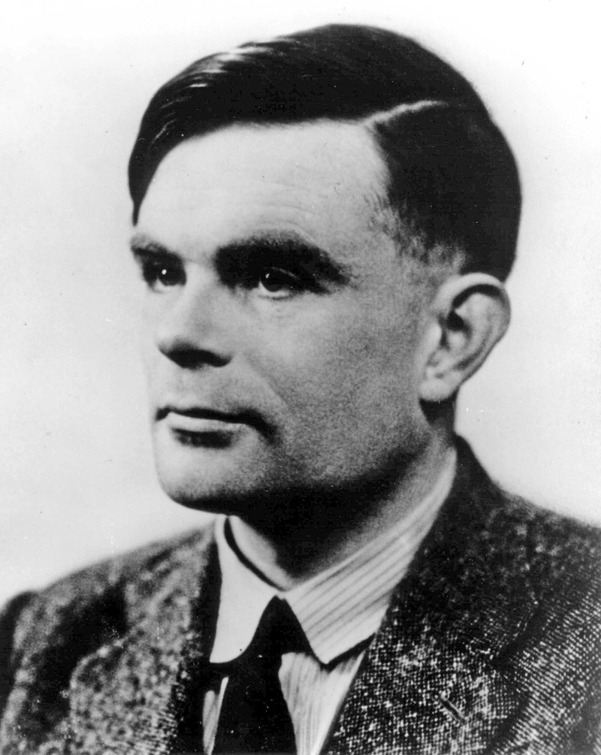
Turing Complete
We have introduced numbers, assignments, input/output, comparisons, and looping constructs.
Such languages are called Turing complete.
If a problem can be solved via computation, it can be solved using only those statements you have already seen.

Slide 3
This is a reasonable piece of code, but it lacks general utility.
It works only for values denoted by the variables x and epsilon.
If we want to reuse it, we need to copy the code, possibly edit the variable names, and paste it where we want it.
If we want to compute cube roots rather than square roots, we have to edit the code.
y = 25
epsilon = 0.01
numGuesses = 0
low = 0.0
high = max(1.0, y)
x = (high + low)/2.0
while abs(x**2-y) >= epsilon:
print('low', low, 'high=', high, 'x=',x)
numGuesses +=1
if x**2 <y:
low = x
else :
high = x
x = (high + low)/2.0
print('numGuesses :', numGuesses)
print(x, ' is close to square root of ', y)

Slide 4
Function Definitions
Python provides several linguistic features that make it relatively easy to generalize and reuse code. The most important is the function.
    In Python each function definition is of the form:
    def name of function (list of formal parameters):
    body of function
For example, we could define the function max by the code:
def max(x, y):
if x > y:
return x
else:
return y

Slide 5
Binding
The sequence of names (x, y in this example) within the parentheses following the function name are the formal parameters of the function.
When the function is used, the formal parameters are bound (as in an assignment statement) to the actual parameters (often referred to as arguments) of the function invocation (also referred to as a function call).
For example, the invocation
max(3, 4)
Binds x to 3 and y to 4.

Slide 6
A function call is an expression, and like all expressions it has a value!
Expression max(3,4)*max(3,2) is 12
Execution of a return statement terminates that invocation of the function.

Slide 7
When a function is called:
The invocation max(3+4, z) will bind the formal parameter x to 7 and the formal parameter y to whatever value the variable z has when the invocation is evaluated.
The point of execution (the next instruction to be executed) moves from the point of invocation to the first statement in the body of the function.
The code in the body of the function is executed until either a return statement is encountered.
-The value of the expression following the return becomes the value of the function invocation
- If there are no more statements to execute, in which case the function returns the value None.

Slide 8
When a function is called:
4. The value of the invocation is the returned value.
5. The point of execution is transferred back to the code immediately following the invocation.
def max(x, y):
if x > y:
return x
else:
return y
a = max(4, 5)
print(a)

Slide 9
Finger Exercise
Write a function isIn that accepts two strings as arguments and returns True if either string occurs anywhere in the other, and False otherwise.

Slide 10
Finger Exercise
Write a function isIn that accepts two strings as arguments and returns True if either string occurs anywhere in the other, and False otherwise.
def isIn(word, letter):
for s in word:
if s == letter:
return True
return False
control = isIn(“ENM104”, “c”):

Slide 11
Keyword Arguments
In Python, there are two ways that formal parameters get bound to actual parameters:
The most common method, which is the only one we have used thus far, is called positional.
2. Python also supports what it calls keyword arguments, in which formals are bound to actuals using the name of the formal parameter.

Slide 12
Consider the function:
def printName(firstName, lastName, reverse):
if reverse:
print(lastName + ', ' + firstName)
else:
print(firstName + ' ' + lastName)
return
printName('Emre', 'Cimen', False)
printName('Emre', 'Cimen', False)
printName('Emre', 'Cimen', reverse = False)
printName('Emre', lastName = 'Cimen', reverse = False)
printName(lastName='Cimen', firstName='Emre', reverse=False)

Slide 13
Default parameter
Keyword arguments are commonly used in conjunction with default parameter values.
def printName(firstName, lastName, reverse = False):
if reverse:
print(lastName + ', ' + firstName)
else:
print(firstName + ' ' + lastName)
return
printName('Emre', 'Cimen')
printName('Emre', 'Cimen’, True)
printName('Emre', 'Cimen', reverse = True)
will print:
Emre Cimen
Cimen, Emre
Cimen, Emre

Slide 14
Scoping
def f(x): #name x used as formal parameter
y=1
x= x + y
print('x =', x)
return x
x=3
y=2
z = f(x) #value of x used as actual parameter print 'z =', z
print('x =', x)
print('y =', y)
will print:
x=4
z=4
x=3
y=2

Slide 15
What is going on here?
Each function defines a new name space, also called a scope.
The formal parameter x and the local variable y that are used in f exist only within the scope of the definition of f.
The assignments in f have no effect at all on the bindings of the names x and y that exist outside the scope of f.

Slide 16
At top level, i.e., the level of the shell, a symbol table keeps track of all names defined at that level and their current bindings.
When a function is called, a new symbol table (sometimes called a stack frame) is created. This table keeps track of all names defined within the function (including the formal parameters) and their current bindings.
When the function completes, its stack frame goes away.

Slide 17
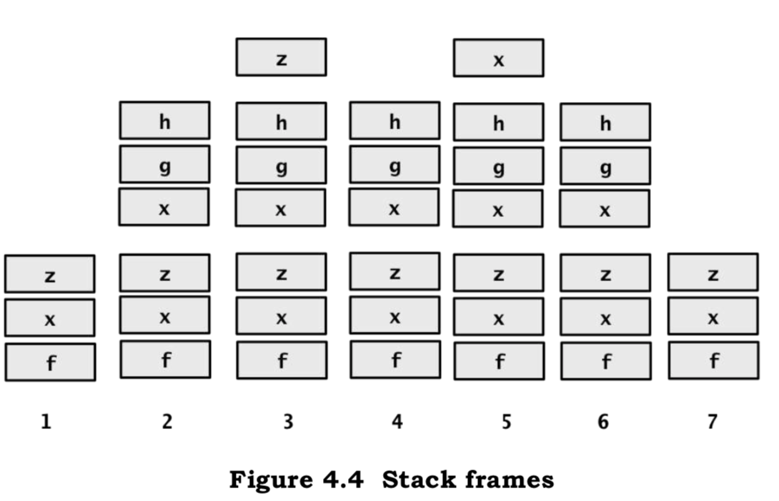
One can always determine the scope of a name by looking at the program text. This is called static or lexical scoping.
def f(x):
def g():
x = 'abc'
print('x =', x)
return
def h():
z=x
print('z =', z)
return
x=x+1
print('x =', x)
h()
g()
print('x =', x)
return g
x=3
z = f(x)
print('x =', x)
print('z =', z)
z()

Slide 18
def f(x):
def g():
x = 'abc'
print('x =', x)
return
def h():
z=x
print('z =', z)
return
x=x+1
print('x =', x)
h()
g()
print('x =', x)
return g
x=3
z = f(x)
print('x =', x)
print('z =', z)
z()
x = 4
z = 4
x = abc
x = 4
x = 3
z = <function f.<locals>.g at 0x10ca0ed08>
x = abc
will print:

Slide 19
Scoping cont.
The order in which references to a name occur is not germane. If an object is bound to a name anywhere in the function body (even if it occurs in an expression before it appears as the left-hand-side of an assignment), it is treated as local to that function.
def f():
print(x)
return
def g():
print(x)
x = 1
return
x = 3
f()
x = 3
g() X

Slide 20
Test Functions
def findRoot(x, power, epsilon):
"""Assumes x and epsilon int or float, power an int,
epsilon > 0 & power >= 1
Returns float y such that y**power is within epsilon of x.
If such a float does not exist, it returns None"""
if x < 0 and power%2 == 0:
return None
low = min(-1.0, x)
high = max(1.0, x)
ans = (high + low)/2.0
while abs(ans**power - x) >= epsilon:
if ans**power < x:
low = ans
else:
high = ans
ans = (high + low)/2.0
return ans
def testFindRoot():
epsilon = 0.0001
for x in (0.25, -0.25, 2, -2, 8, -8):
for power in range(1, 4):
print('Testing x = ' + str(x) +\
' and power = ' + str(power))
result = findRoot(x, power, epsilon)
if result == None:
print(' No root')
else:
print(' ', result**power, '~=', x)

Slide 21
Test Functions cont.
The function testFindRoot is almost as long as findRoot itself. To inexperienced programmers, writing test functions such as this often seems to be a waste of effort.
It certainly beats typing test cases into the shell over and over again during debugging.
The text between the triple quotation marks is called a docstring in Python.
These docstrings can be accessed using the built-in function help.

Slide 22
Function help
def findRoot(x, power, epsilon):
"""Assumes x and epsilon int or float, power an int,
epsilon > 0 & power >= 1
Returns float y such that y**power is within epsilon of x.
If such a float does not exist, it returns None"""
if x < 0 and power%2 == 0:
return None
low = min(-1.0, x)
high = max(1.0, x)
ans = (high + low)/2.0
while abs(ans**power - x) >= epsilon:
if ans**power < x:
low = ans
else:
high = ans
ans = (high + low)/2.0
return ans
help(findRoot)
will print:
Help on function findRoot in module __main__:
findRoot(x, power, epsilon)
Assumes x and epsilon int or float, power an int,
epsilon > 0 & power >= 1
Returns float y such that y**power is within epsilon of x.
If such a float does not exist, it returns None

Slide 23
Specification
A specification of a function defines a contract between the implementer of a function and those who will be writing programs that use the function (clients).
This contract can be thought of as containing two parts:
1. Assumptions: These describe conditions that must be met by clients of the function.
2. Guarantees: These describe conditions that must be met by the function, provided that it has been called in a way that satisfies the assumptions.

Slide 24
Decomposition and Abstraction
Decomposition creates structure. It allows us to break a problem into modules that are reasonably self-contained, and that may be reused in different settings.
Abstraction hides detail. It allows us to use a piece of code as if it were a black box—that is, something whose interior details we cannot see, don’t need to see, and shouldn’t even want to see.

Slide 25
Recursion
A recursive definition is made up of two parts:
There is at least one base case that directly specifies the result for a special case
And there is at least one recursive (inductive) case that defines the answer in terms of the answer to the question on some other input, typically a simpler version of the same problem.

Slide 26
Factorial
The world’s simplest recursive definition is probably the factorial function on natural numbers. The classic inductive definition is:
1! = 1
(n + 1)! = (n + 1) * n!
def factI(n):
"""Assumes that n is an int > 0 Returns n!"""
result = 1
while n > 1:
result = result * n
n -= 1
return result
def factR(n):
"""Assumes that n is an int > 0 Returns n!"""
if n == 1:
return n
else:
return n*factR(n - 1)

Slide 27
Fibonacci Numbers
1, 1, 2, 3, 5, 8, 13, 21, 34, …
def fib(n):
"""Assumes n an int >= 0
Returns Fibonacci of n"""
if n == 0 or n == 1:
return 1
else:
return fib(n-1) + fib(n-2)
def testFib(n):
for i in range(n+1):
print('fib of', i, '=', fib(i))

Slide 28
Palindromes
A palindrome is a word, number, phrase, or other sequence of characters which reads the same backward as forward, such as madam, racecar.
We will see implementation of isPalindrome is an example of a problem solving principle known as divide-and-conquer.
the subproblems are easier to solve than the original problem
solutions of the subproblems can be combined to solve the original problem.

Slide 29
Palindromes
def isPalindrome(s):
"""Assumes s is a str Returns True if s is a palindrome; False otherwise.
Punctuation marks, blanks, and capitalization are ignored."""
def toChars(s):
s = s.lower()
letters = ''
for c in s:
if c in 'abcdefghijklmnopqrstuvwxyz':
letters = letters + c
return letters
def isPal(s):
print(' isPal called with', s)
if len(s) <= 1:
print(' About to return True from base case')
return True
else:
answer = s[0] == s[-1] and isPal(s[1:-1])
print(' About to return', answer, 'for', s)
return answer
return isPal(toChars(s))
print(isPalindrome("race Car."))
will print:
isPal called with racecar
isPal called with aceca
isPal called with cec
isPal called with e
About to return True from base case
About to return True for cec
About to return True for aceca
About to return True for racecar
True

Slide 30
s =
r | a | c | e |  | C | a | r | .
toChars(s) will return
r | a | c | e | c | a | r
isPal(s):
r | a | c | e | c | a | r
True

Slide 31
Global Variables
All of the functions we have written communicate with their environment solely through their parameters and return values.
In computer programming, a global variable is a variable with global scope, meaning that it is visible (hence accessible) throughout the program. The set of all global variables is known as the global environment or global state (Wikipedia).

Slide 32
Global Variables
In each function, the line of code global numFibCalls tells Python that the name numCalls should be defined at the outermost scope of the module.
def fib(x):
"""Assumes x an int >= 0
Returns Fibonacci of x"""
global numFibCalls
numFibCalls += 1
if x == 0 or x == 1:
return 1
else:
return fib(x-1) + fib(x-2)
def testFib(n):
for i in range(n+1):
global numFibCalls
numFibCalls = 0
print('fib of', i, '=', fib(i))
print('fib called', numFibCalls, 'times.')

Slide 33
References
John V. Guttag, Introduction to Computation and Programming Using Python, The MIT Press Cambridge, Massachusetts London, England, 2013

Slide 34
INTRODUCTION to COMPUTATION & PROGRAMMING FOR IE
Assoc. Prof. Dr. Gürkan ÖZTÜRK & Assist. Prof. Dr. Emre ÇİMEN
gurkan.o@eskisehir.edu.tr & ecimen@eskisehir.edu.tr
Week 09

